Slide 1


Database Using SQL Server & Raw Data available over my GitHub Profile
SQL Triggers With 12 Most Used Queries
AnshLibrary

Slide 2
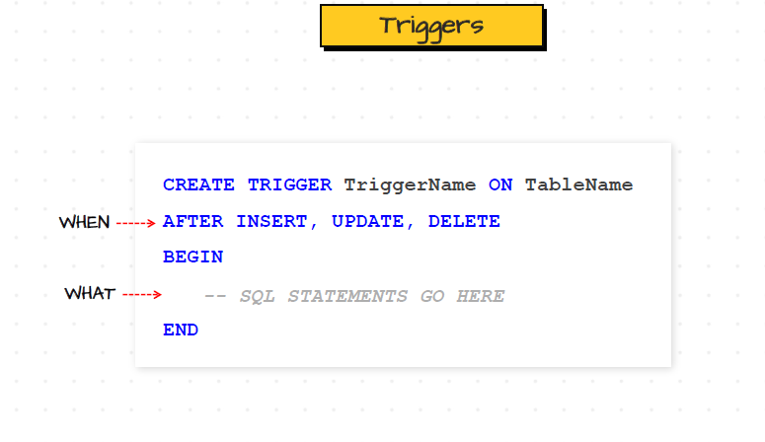
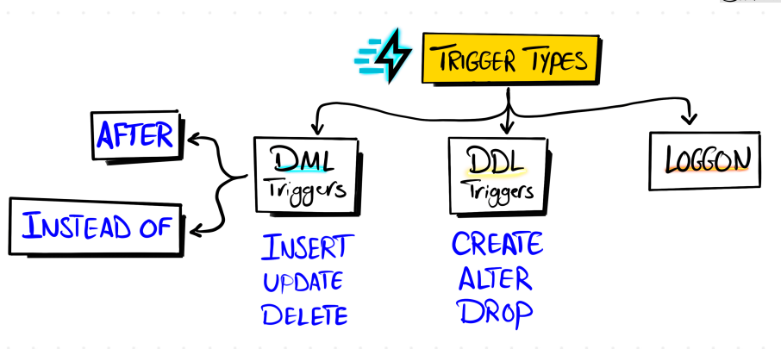
What is a Trigger
A trigger is a special kind of stored procedure that automatically executes when an event (INSERT, UPDATE, DELETE) occurs on a table or view.
Syntax :
Trigger Types:

Slide 3
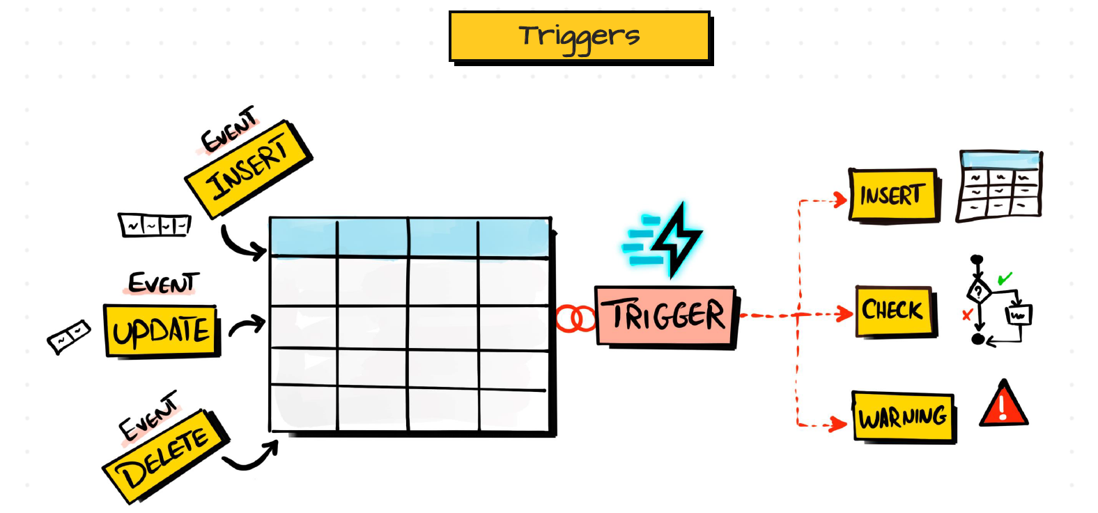
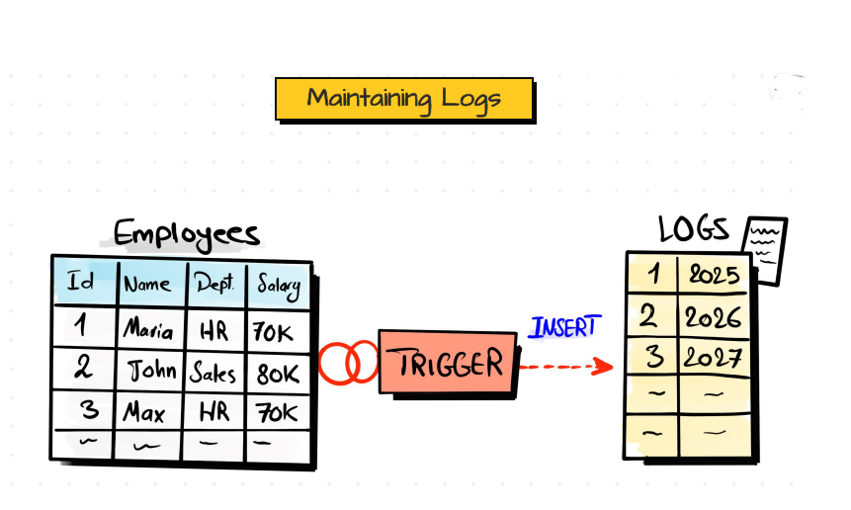
Why We Using :
Enforce business rules automatically on data changes.
Log changes for auditing purposes.
Validate data before it's inserted or updated.
Send alerts or notifications based on data events.
Automate repetitive tasks tied to data changes.

Slide 4

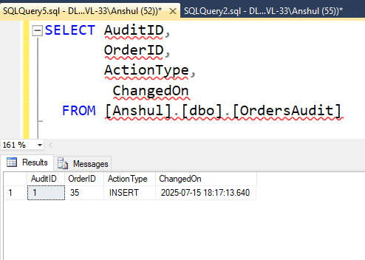
Audit Log After New Order Insert
--Created Table First Like This
--Create Trigger With This Select Query
CREATE TABLE OrdersAudit (
AuditID INT IDENTITY(1,1) PRIMARY KEY,
OrderID INT,
ActionType VARCHAR(10),
ChangedOn DATETIME DEFAULT GETDATE()
);
CREATE TRIGGER trg_Audit_Order_Insert
ON Orders
AFTER INSERT
AS
BEGIN
INSERT INTO OrdersAudit (OrderID, ActionType)
SELECT OrderID, 'INSERT' FROM inserted;
END;
--Once you insert any values into Orders table
then you able to find that records in this OrdersAudit table
Use Case: Maintain audit log when new orders are added.
AnshLibrary

Slide 5

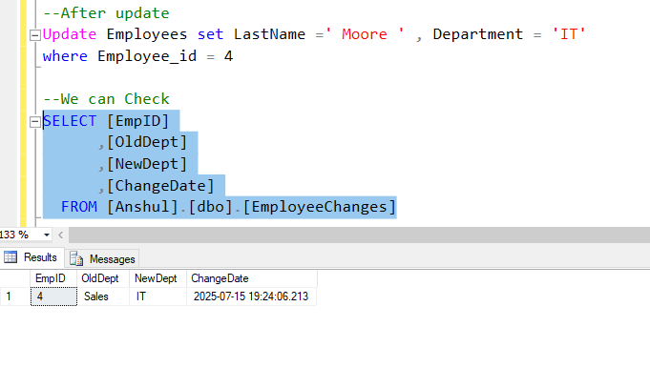
Join Orders with Customers (Data Enrichment)
sql
Track Employee Promotions (Department Changes)
CREATE TABLE EmployeeChanges (
EmpID INT,
OldDept VARCHAR(50),
NewDept VARCHAR(50),
ChangeDate DATETIME DEFAULT GETDATE()
);
CREATE TRIGGER trg_Employee_DeptChange
ON Employees
AFTER UPDATE
AS
BEGIN
INSERT INTO EmployeeChanges (EmpID, OldDept, NewDept)
SELECT d.Employee_id, d.Department, i.Department
FROM deleted d
JOIN inserted i ON d.Employee_id = i.Employee_id
WHERE d.Department <> i.Department;
END;
Use Case: Track internal movement in HR systems
AnshLibrary

Slide 6

Prevent Orders with NULL Shipping Address
CREATE TRIGGER trg_Prevent_Null_ShipAddress
ON Orders
AFTER INSERT, UPDATE
AS
BEGIN
IF EXISTS (SELECT 1 FROM inserted WHERE ShipAddress IS NULL)
BEGIN
RAISERROR ('ShipAddress cannot be NULL', 16, 1);
ROLLBACK;
END
END;
Use Case: Enforce data quality
AnshLibrary

Slide 7

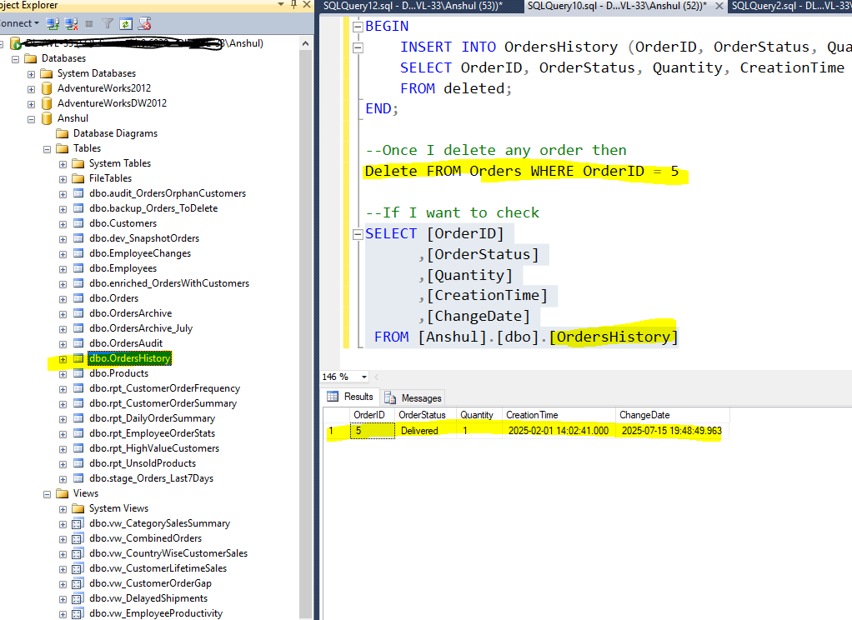
Auto-Archive Orders on DELETE
CREATE TABLE OrdersHistory (
OrderID INT,
OrderStatus VARCHAR(50),
Quantity INT,
CreationTime DATETIME,
ChangeDate DATETIME DEFAULT GETDATE()
);
CREATE TRIGGER trg_Archive_Orders_OnDelete
ON Orders
AFTER DELETE
AS
BEGIN
INSERT INTO OrdersHistory (OrderID, OrderStatus, Quantity, CreationTime)
SELECT OrderID, OrderStatus, Quantity, CreationTime
FROM deleted;
END;
--Once I delete any row
Delete FROM Orders WHERE OrderID = 5
Use Case: Keep deleted orders archived for historical access.
AnshLibrary

Slide 8

Restrict Deleting Managers with Active Reportees
CREATE TRIGGER trg_Prevent_Manager_Delete
ON Employees
INSTEAD OF DELETE
AS
BEGIN
IF EXISTS (
SELECT 1 FROM Employees e
JOIN deleted d ON e.ManagerID = d.Employee_id
)
BEGIN
RAISERROR ('Cannot delete manager with active reportees.', 16, 1);
RETURN;
END
ELSE
BEGIN
DELETE FROM Employees WHERE Employee_id IN (SELECT Employee_id FROM deleted);
END
END;
Used Case :Prevent accidental deletion of hierarchy.
AnshLibrary

Slide 9

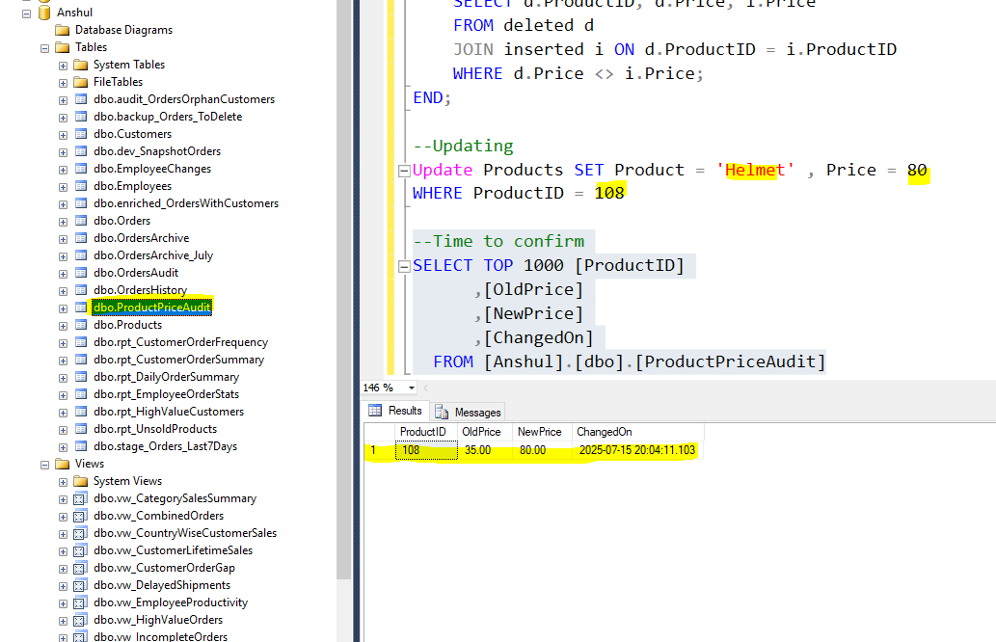
Log Product Price Changes
CREATE TABLE ProductPriceAudit (
ProductID INT,
OldPrice DECIMAL(10,2),
NewPrice DECIMAL(10,2),
ChangedOn DATETIME DEFAULT GETDATE()
);
CREATE TRIGGER trg_ProductPriceChange
ON Products
AFTER UPDATE
AS
BEGIN
INSERT INTO ProductPriceAudit (ProductID, OldPrice, NewPrice)
SELECT d.ProductID, d.Price, i.Price
FROM deleted d
JOIN inserted i ON d.ProductID = i.ProductID
WHERE d.Price <> i.Price;
END;
Use Case: Track pricing history for audit.
AnshLibrary

Slide 10

Prevent Orders for Discontinued Products
CREATE TRIGGER trg_Discontinued_Product
ON Orders
AFTER INSERT
AS
BEGIN
IF EXISTS (
SELECT 1 FROM inserted i
LEFT JOIN Products p
ON i.ProductID = p.ProductID
WHERE p.Product IS NULL
)
BEGIN
RAISERROR ('Product does not exist or is discontinued.', 16, 1);
ROLLBACK;
END
END;
Use Case: Block invalid SKUs..
AnshLibrary

Slide 11

Sync New Customers to CRM Table
CREATE TABLE CRM_Customers (
CustomerID INT,
FullName VARCHAR(100),
Country VARCHAR(50),
Score INT
);
CREATE TRIGGER trg_Sync_New_Customer
ON Customers
AFTER INSERT
AS
BEGIN
INSERT INTO CRM_Customers (CustomerID, FullName, Country, Score)
SELECT Customer_id, First_Name + ' ' + ISNULL(Last_Name, ''), Country, Score
FROM inserted;
END;
Use Case: Real-time CRM sync on new customer creation.
AnshLibrary

Slide 12

Prevent Sales Over ANY AMOUNT in One Order
CREATE TRIGGER trg_Limit_High_Sales
ON Orders
AFTER INSERT
AS
BEGIN
IF EXISTS (SELECT 1 FROM inserted WHERE Sales > 150)
BEGIN
RAISERROR ('Sales exceeds allowed transaction limit.', 16, 1);
ROLLBACK;
END
END;
Use Case: Fraud detection or compliance enforcement.
AnshLibrary

Slide 13

Log Failed Shipments
CREATE TABLE FailedShipments (
OrderID INT,
ShipStatus VARCHAR(50),
LoggedOn DATETIME DEFAULT GETDATE()
);
CREATE TRIGGER trg_Log_Failed_Shipment
ON Orders
AFTER UPDATE
AS
BEGIN
INSERT INTO FailedShipments (OrderID, ShipStatus)
SELECT OrderID, OrderStatus FROM inserted
WHERE OrderStatus = 'Failed';
END;
Use Case: Monitor logistics failure for escalation.
AnshLibrary

Slide 14
11
Track Customer Score Updates
CREATE TABLE CustomerScoreAudit (
CustomerID INT,
OldScore INT,
NewScore INT,
ChangedOn DATETIME DEFAULT GETDATE()
);
CREATE TRIGGER trg_CustomerScoreAudit
ON Customers
AFTER UPDATE
AS
BEGIN
INSERT INTO CustomerScoreAudit (CustomerID, OldScore, NewScore)
SELECT d.Customer_id, d.Score, i.Score
FROM deleted d
JOIN inserted i
ON d.Customer_id = i.Customer_id
WHERE d.Score <> i.Score;
END;
Use Case: Record credit score history.
AnshLibrary

Slide 15
12
Auto Update OrderStatus on High Quantity
CREATE TRIGGER trg_HighQty_AutoHold
ON Orders
AFTER INSERT
AS
BEGIN
UPDATE o
SET OrderStatus = 'Hold'
FROM Orders o
JOIN inserted i
ON o.OrderID = i.OrderID
WHERE i.Quantity >= 10;
END;
Use Case: Flag bulk orders for manual review.
AnshLibrary

